Slide 1


What’s in a Name?
Gabriel Alves
Scott Boxberger
Erik Figge
Rajeev Kulshrestha

Slide 2

What questions did we address?
How have baby names changed in popularity over the years?
Is there a difference in Male vs Female trends?
Are there state/regional differences in name popularity?
Have names shifted in gender popularity?
Does Pop Culture, Sports, etc. influence name selection?

Slide 3
Data Cleanup
Source: Kaggle.com dataset (extracted from data.gov, via US Social Security Administration)
National File
Male
Female
State File
Male
Female

Slide 4
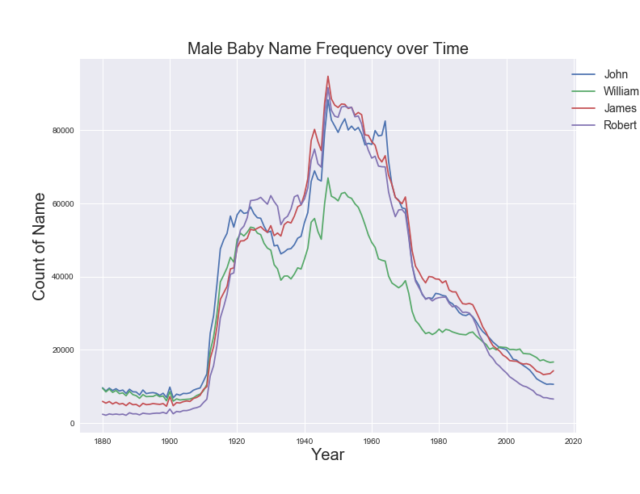
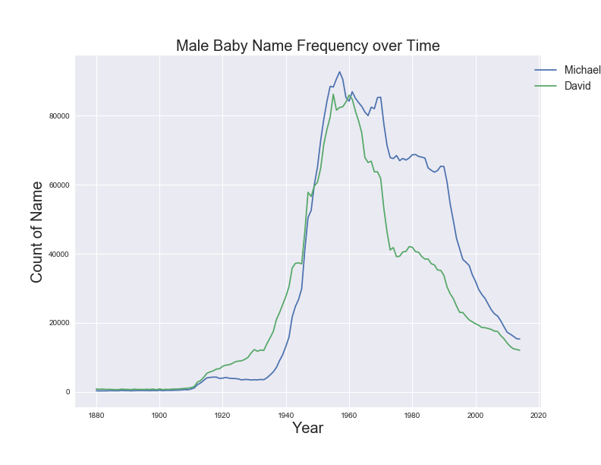
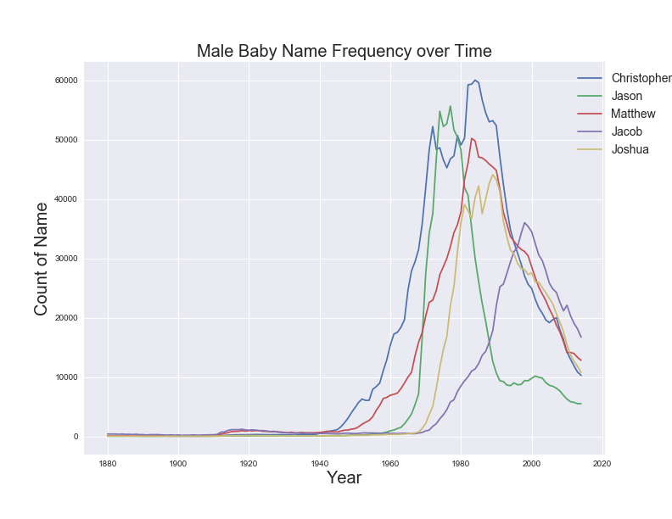
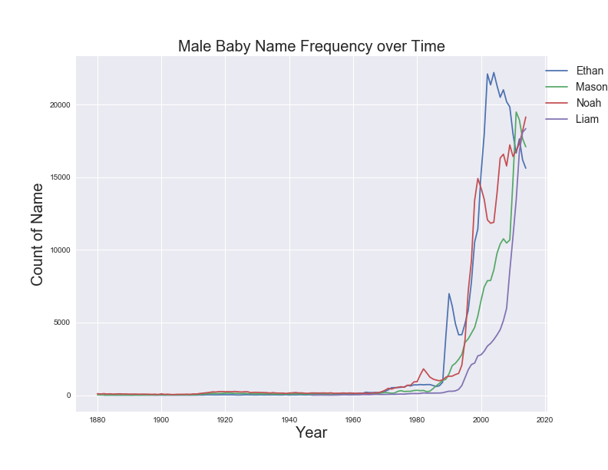
Baby Name Popularity over Time (Male)
Top 3 in any Year
15 Male Names
Longer popularity duration in early years
More volatile in later years

Slide 5
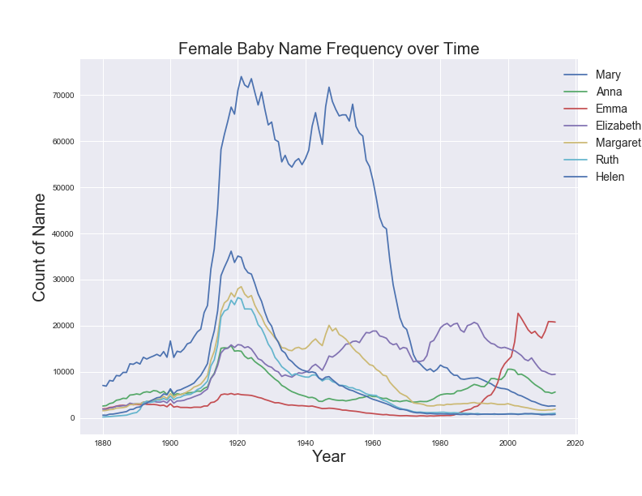
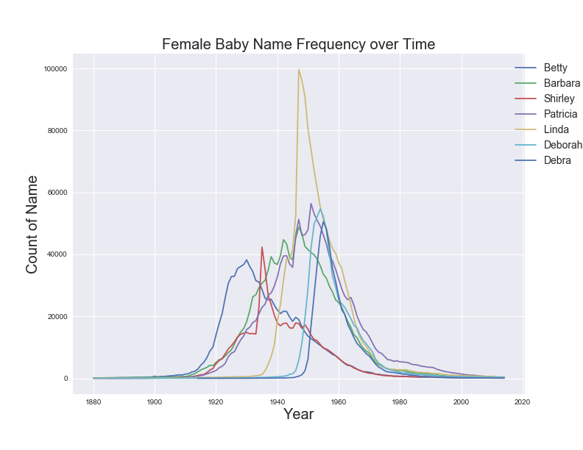
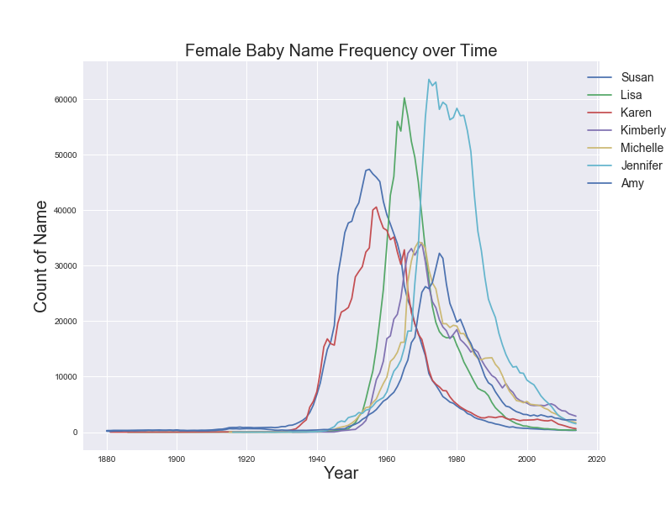
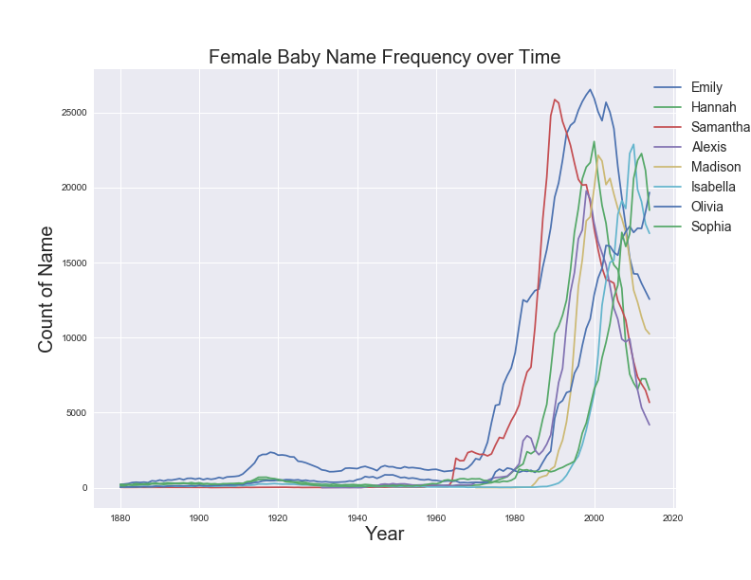
Baby Name Popularity over Time (Female)
Top 3 in any Year
37 Female Names (over twice as many as male)
Longer popularity duration in early years
More volatile in later years
Let’s Talk About Linda

Slide 6
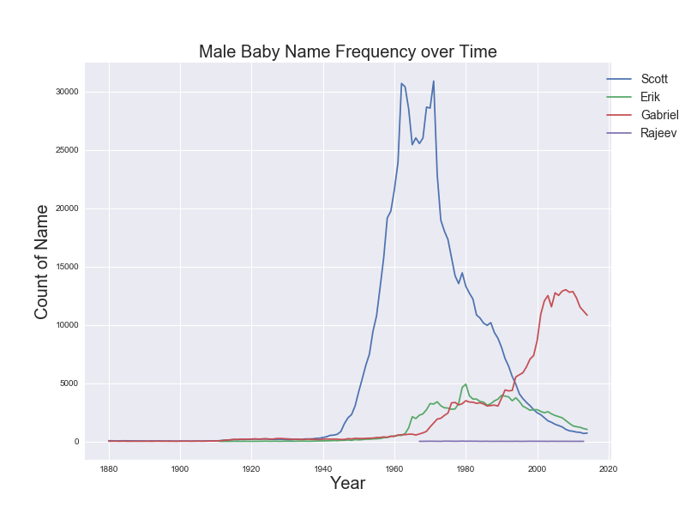
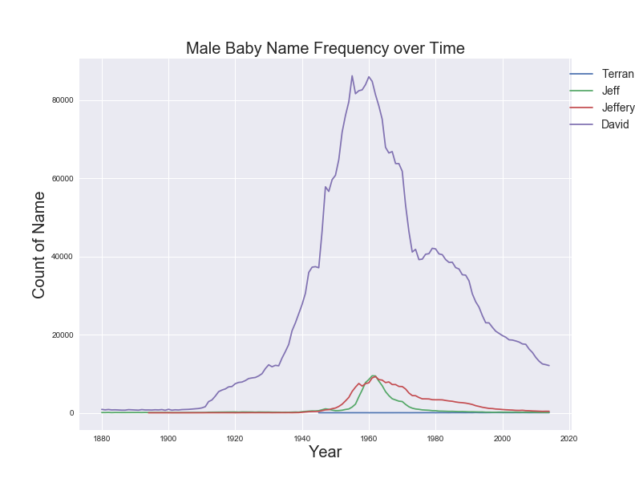
Team/Instructor Name Popularity

Slide 7
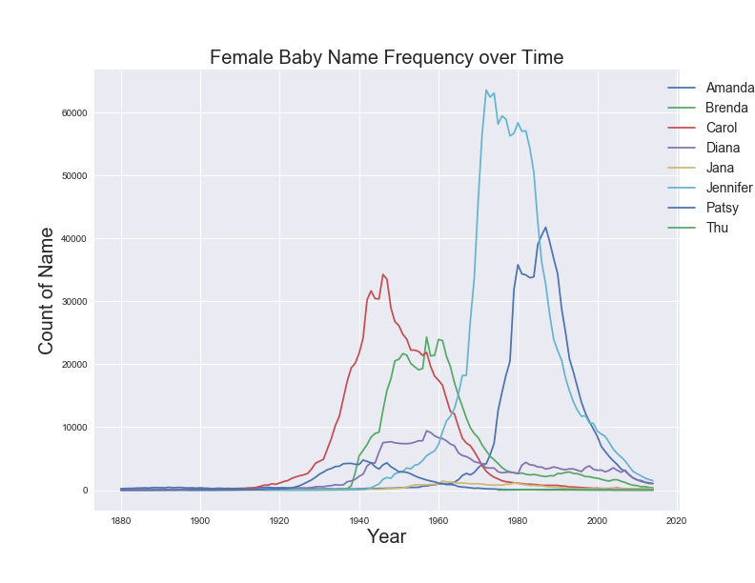
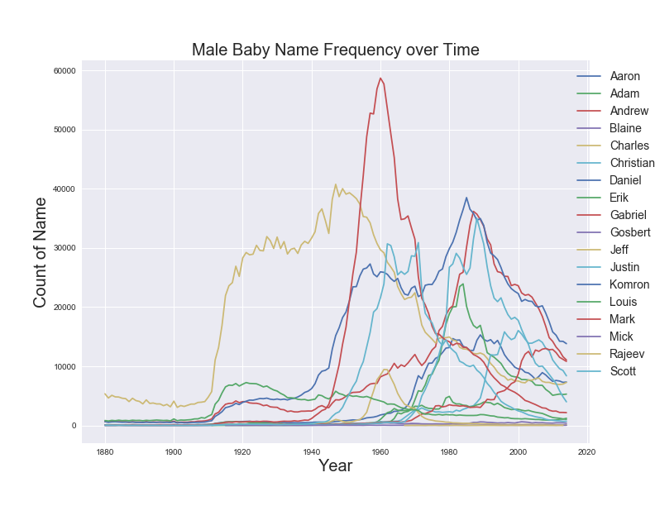
Class Name Popularity
Twitter: @RocChalkChicken
#Name_Male_XX_19XX or #Name_Female_XX_19XX
#Scott_Male_KS_1969

Slide 8
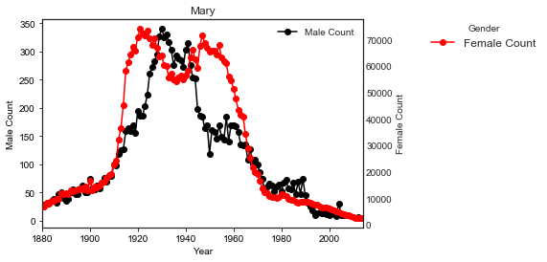
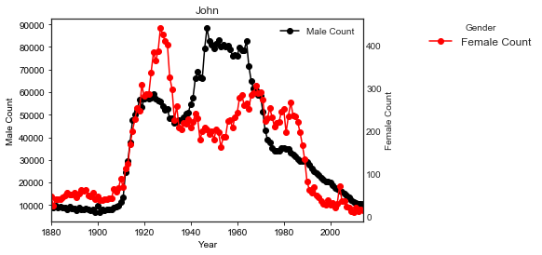
Mary vs. john

Slide 9

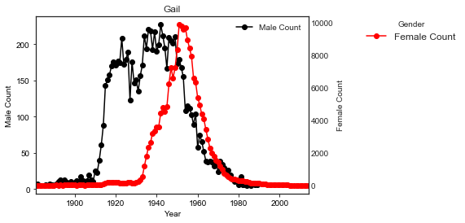
Gail
Gail Russell, an American film and television actress.

Slide 10
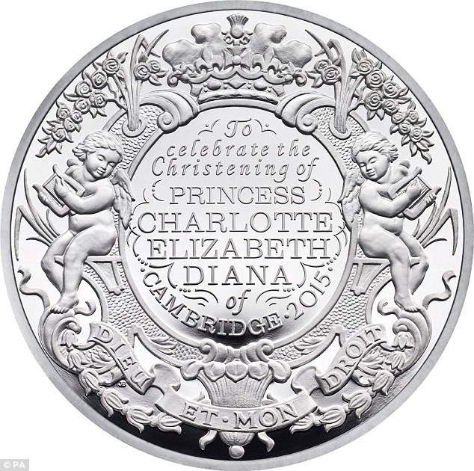
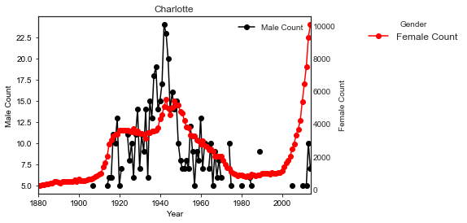
Charlotte
The birth of princess Charlotte of Cambridge has a massive influence.

Slide 11
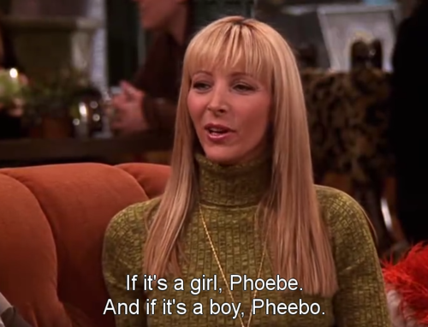
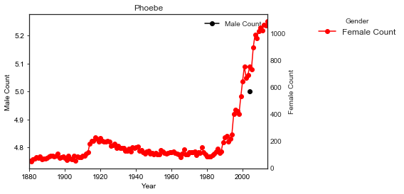
Phoebe
TV Show’s influence
on babies’ names;
Friends started in 1994.

Slide 12
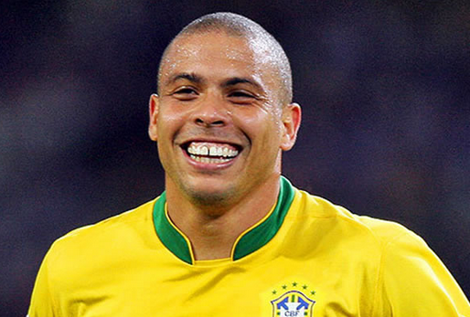
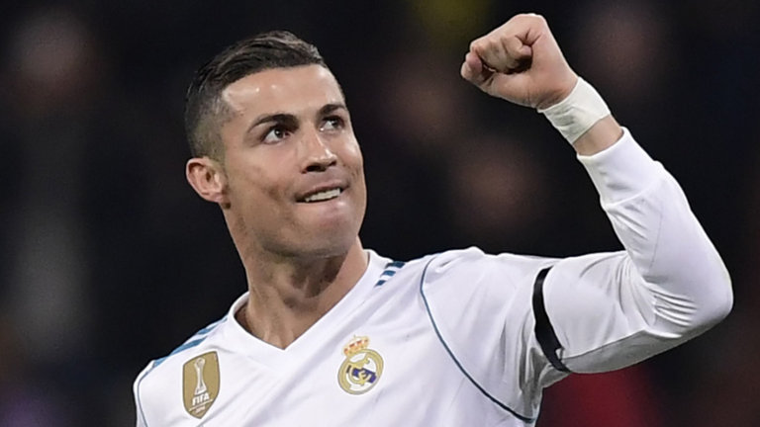
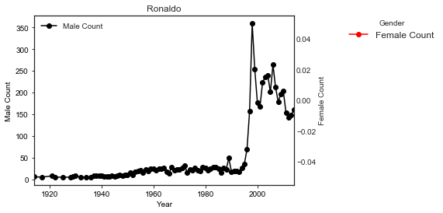
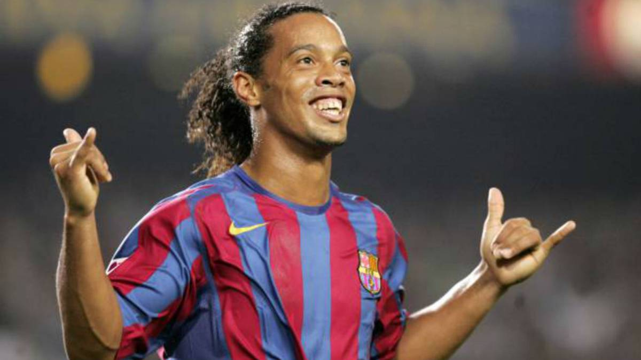
Ronaldo
Mainly after the World Cup
in 1994 in the United States, Ronaldo’s names started
to appear.

Slide 13
Appendix

Slide 14
iPython Notebooks

